Slide 1
Language Detection SYSTEM
HASNAIN ALI (SP20-BCS-122)
AYESHA TARIQ (SP20-BCS-020)
AZEEM MANZOOR (SP20-BCS-046)
ADNAN SAFDAR (SP20-BCS-116)

Slide 2
WHY WE NEED TO IDENTIFY THE LANGUAGE OF TEXT?
Language which is foreign and unfamiliar to the reader tends to emphasize the differences between writer and reader, and makes the message difficult to understand.
It is important to know the language of text before other actions (i.e. translation/ sentiment analysis) can be taken.

Slide 3
About Our project

Slide 4
PYTHON LIBRARIES
import pandas as pd
import numpy as np
#Collection of text Document into matrix of token count
from sklearn.feature_extraction.text import CountVectorizer

Slide 5
ML CLASSIFERS
#import different ML classifiers
from sklearn.model_selection import train_test_split
from sklearn.naive_bayes import MultinomialNB
from sklearn import preprocessing
from sklearn.naive_bayes import GaussianNB, BernoulliNB, MultinomialNB
from sklearn.svm import SVC, LinearSVC
from sklearn.linear_model import LogisticRegression
from sklearn.tree import DecisionTreeClassifier
from sklearn.ensemble import RandomForestClassifier
from sklearn.neural_network import MLPClassifier
from sklearn.neighbors import KNeighborsClassifier

Slide 6
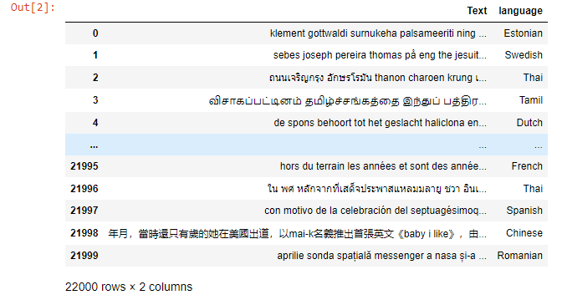
DATA SET
data = pd.read_csv("https://raw.githubusercontent.com/amankharwal/website-data/master/dataset.csv")

Slide 7

DATA SET CONTAIN NO NULL VALUES
data.info()
data.isnull().sum()

Slide 8
LANGUAGES IN DATA SET
Sr# | Language
1. | Estonian
2. | Swedish
3. | English
4. | Russian
5. | Romanian
6. | Persian
7. | Pushto
8. | Spanish
9. | Hindi
10. | Korean
11. | Chinese
12. | French
13. | Portuguese
14. | Indonesian
15. | Urdu
16. | Latin
17. | Turkish
18. | Japanese
19. | Dutch
20. | Tamil
21. | Thai
22 | Arabic

Slide 9
COUNT VECTORIZER
CV = CountVectorizer() #CountVectorizer
X = CV.fit_transform(x)
X

Slide 10
SPLITTING OF DATA SET
SPLITTING WITH THE RATIO OF 67:33

Slide 11
SELECTING A CLASSIFIER
#select a classifier
# model = GaussianNB()
# model = BernoulliNB()
model = MultinomialNB()
#other ML classifiers
# model = SVC()
# model=LinearSVC()
# model=LogisticRegression()
# model = RandomForestClassifier()
# model = DecisionTreeClassifier()
# model=MLPClassifier() #most overfitting #accuracy 97
# model=KNeighborsClassifier(n_neighbors=4)

Slide 12
MULTINOMIAL NAÏVE BAYES ALGORITHM
Multinomial Naive Bayes algorithm is a probabilistic learning method that is mostly used in Natural Language Processing (NLP). The algorithm is based on the Bayes theorem and predicts the tag of a text such as a piece of email or newspaper article. It calculates the probability of each tag for a given sample and then gives the tag with the highest probability as output.

Slide 13
P(A|B) = P(A) * P(B|A)/P(B)
P(B) = prior probability of B
P(A) = prior probability of class A
P(B|A) = occurrence of predictor B given class A probability

Slide 14
We have the text “This est Machine Learning” (est actually means “is” in French)
This | est | Machine | Learning
English | French | English | English

Slide 15
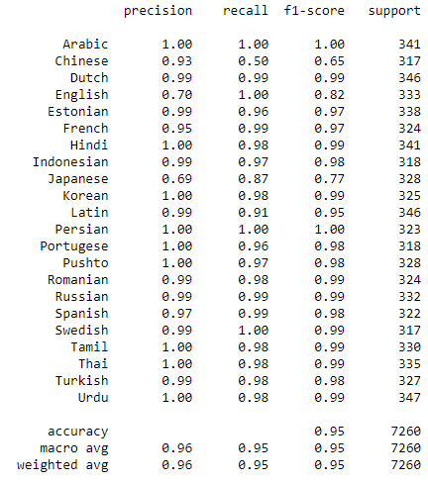
CLASSIFICATION REPORT

Slide 16
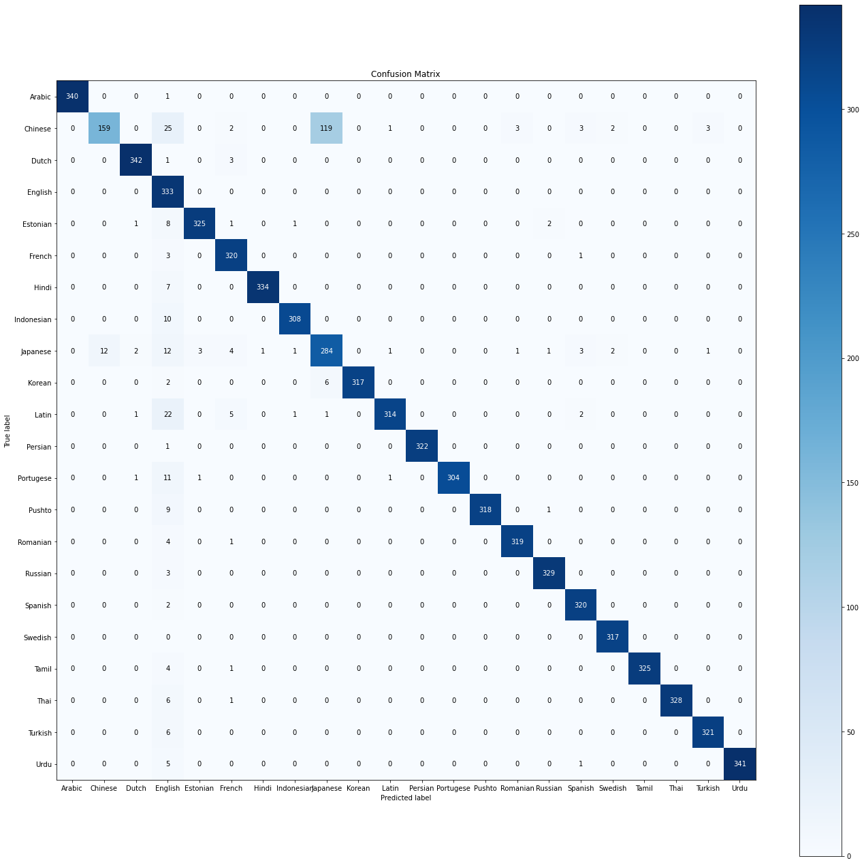
CONFUSION MATRIX

Slide 17

ACCURACY
model_acc = accuracy_score(y_test, pred)*100
print(str(model_acc))

Slide 18
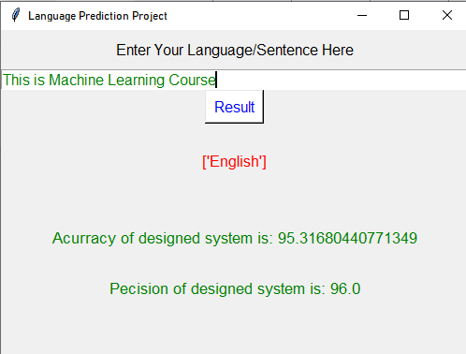
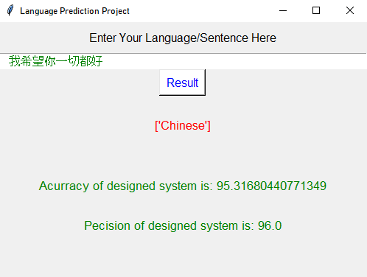
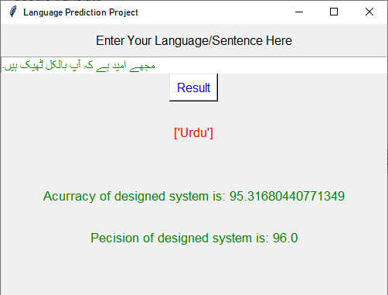
Final output

Slide 19
Scope
Automatic language detection is the first step towards achieving a variety of tasks like detecting the source language for machine translation, improving the search relevancy by personalizing the search results according to the query language, providing uniform search box for a multilingual dictionary, tagging data stream from social media with appropriate language etc. While classifying languages belonging to disjoint groups is not hard, disambiguation of languages originating from the same source and dialects still pose a considerable challenge in the area of natural language processing.

Slide 20
Future Work
Living in such a modern era we’re still facing the problem that on call both sides individuals must speak in the same language only then they’ll be able to communicate. This project will solve this problem by converting the language of one side individual to the desired language of the listener on another side. Like if on one side the speaker speaks in Pashto so on the other side listener will listen in Punjabi and when the Punjabi speaks so on the other side the listener will listen in Pashto. The same scenario can be applied to all languages.
Also, this concept can be generalized for other programs like video listening directly in your desired language, automatically listening to someone in your desired language, etc.

Slide 21
Any Questions?

Slide 22
Thankyou

